Slide 2
Excellent concept
Reduces plotting on chart- hence paper saving
Saving is easy
Very good even for a busy op practitioner and helps us gathering data.
We can make a pan India Data collection very easily
However need some modification

Slide 3
Example
Age 9 months
Weight- 7.5 kg
Length- 70cm
HC- 42cm

Slide 4
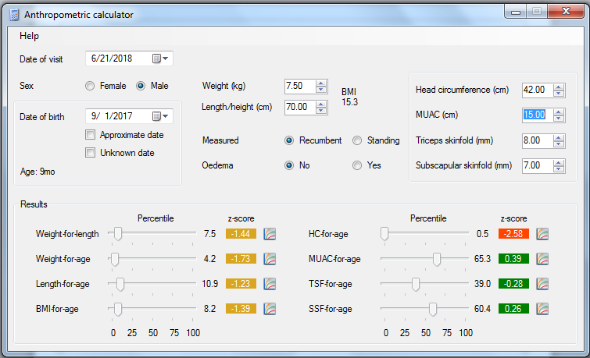
How it is supposed to be
Length for age- is at 11th centile i.e. 10th-25th centile
Weight for age- is at 5th centile i.e. 5th-10th centile
BMI for age is at 8th centile i.e. 5th-10th centile

Slide 5
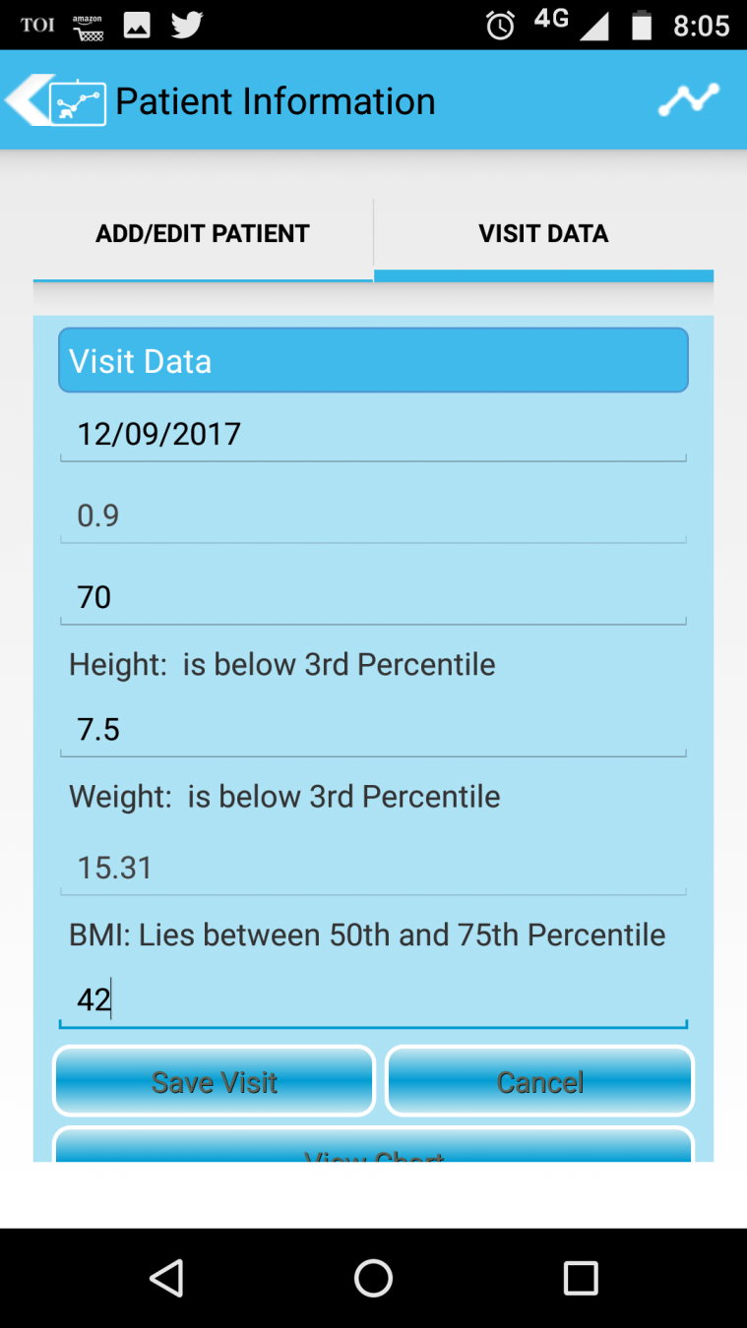
What it shows?

Slide 6
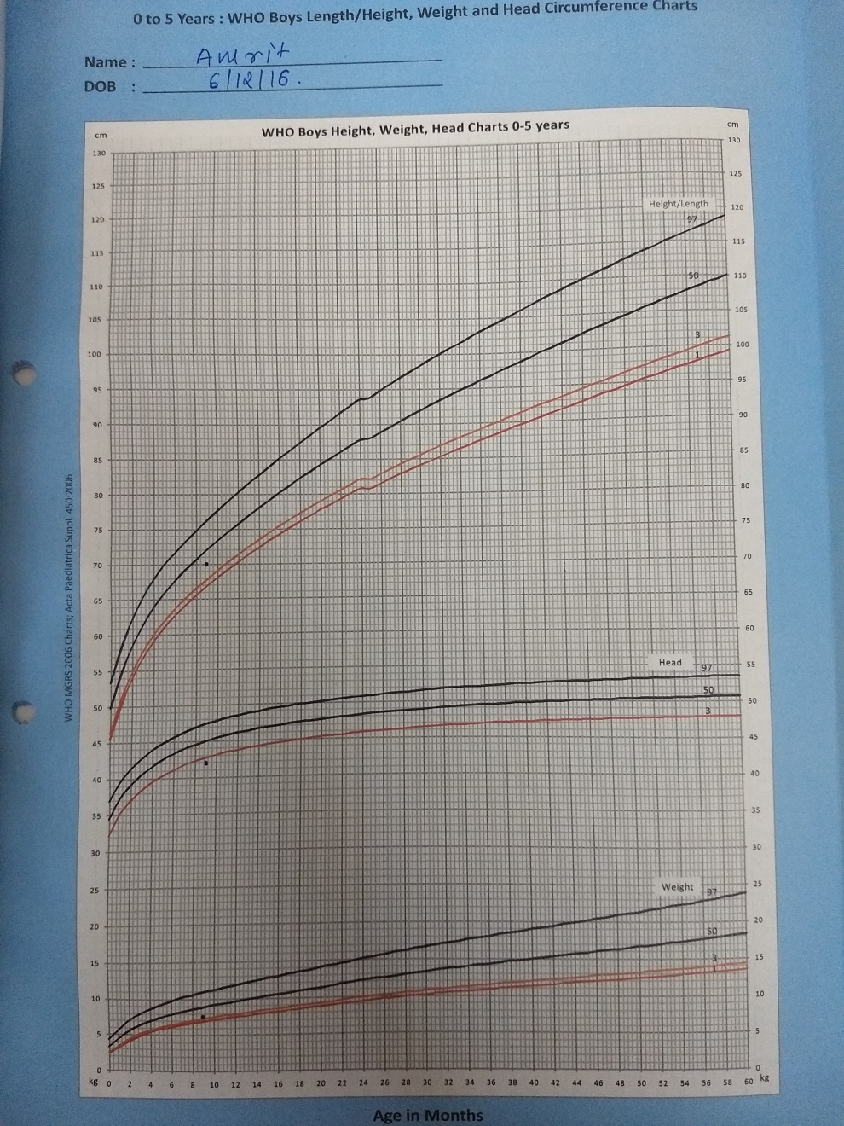
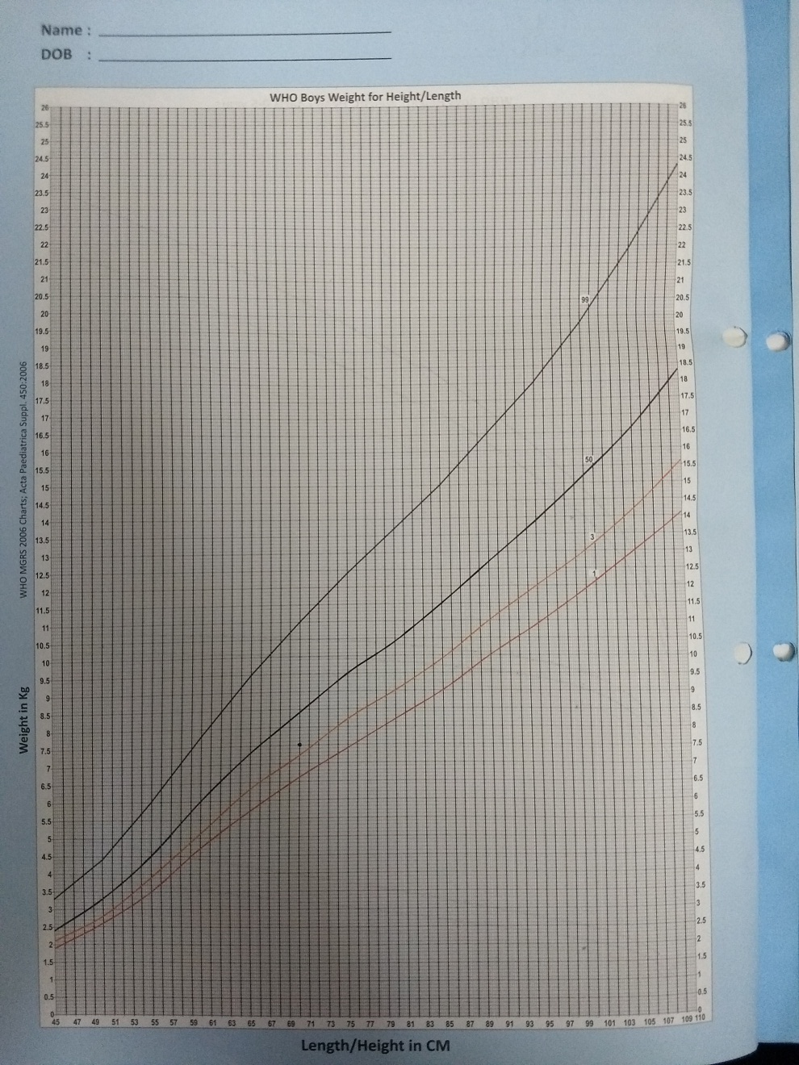
How chart should look?

Slide 7
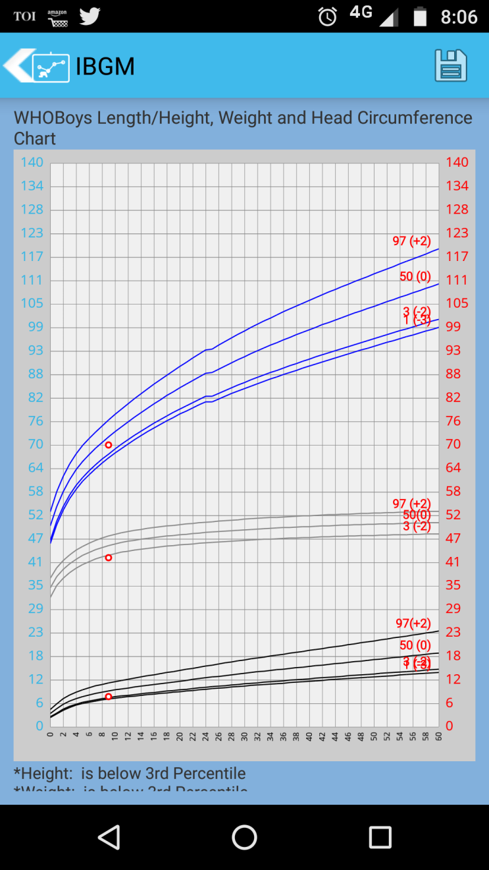
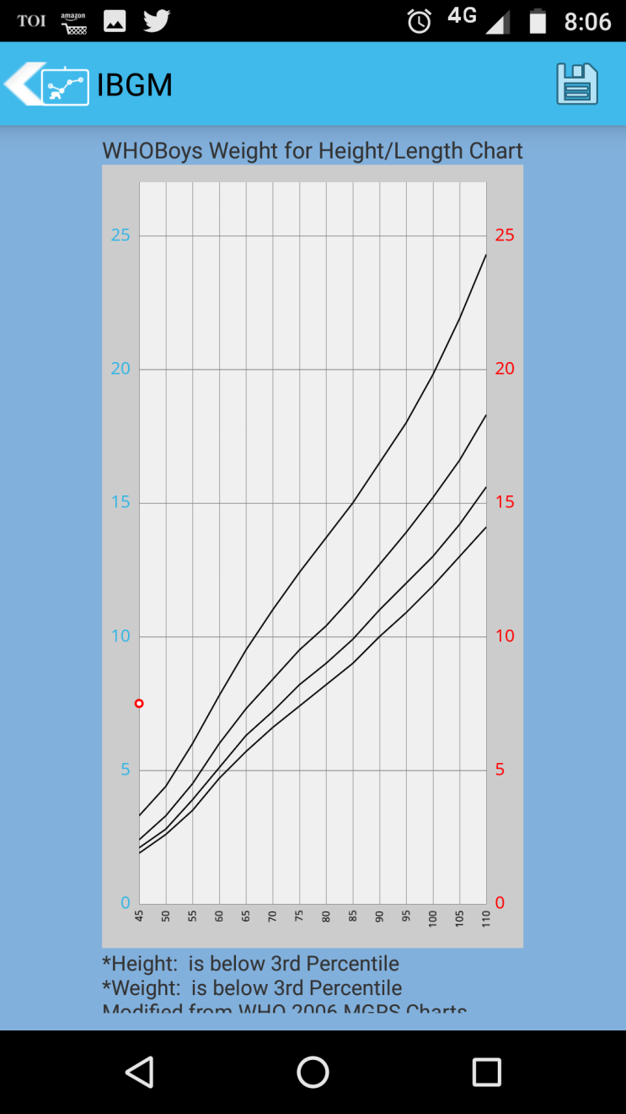
What it shows?

Slide 8
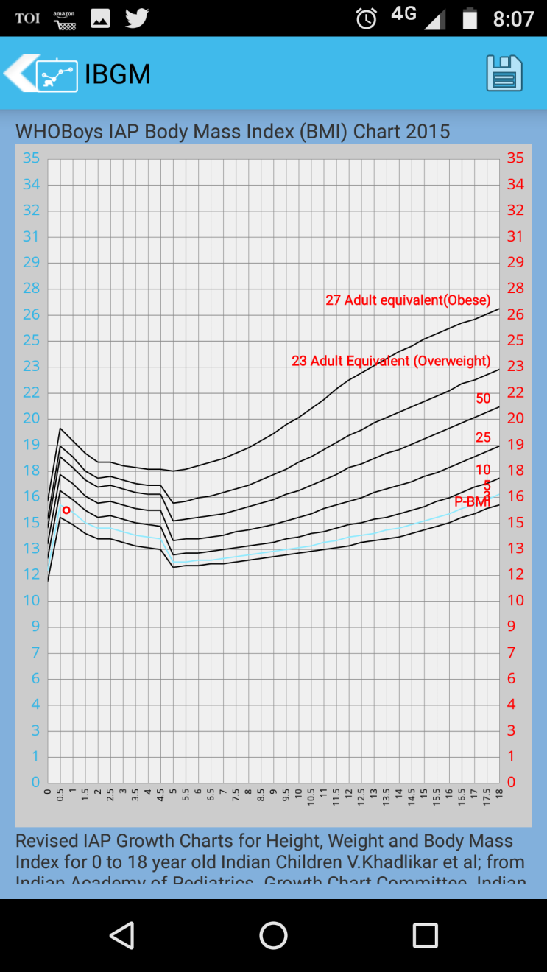
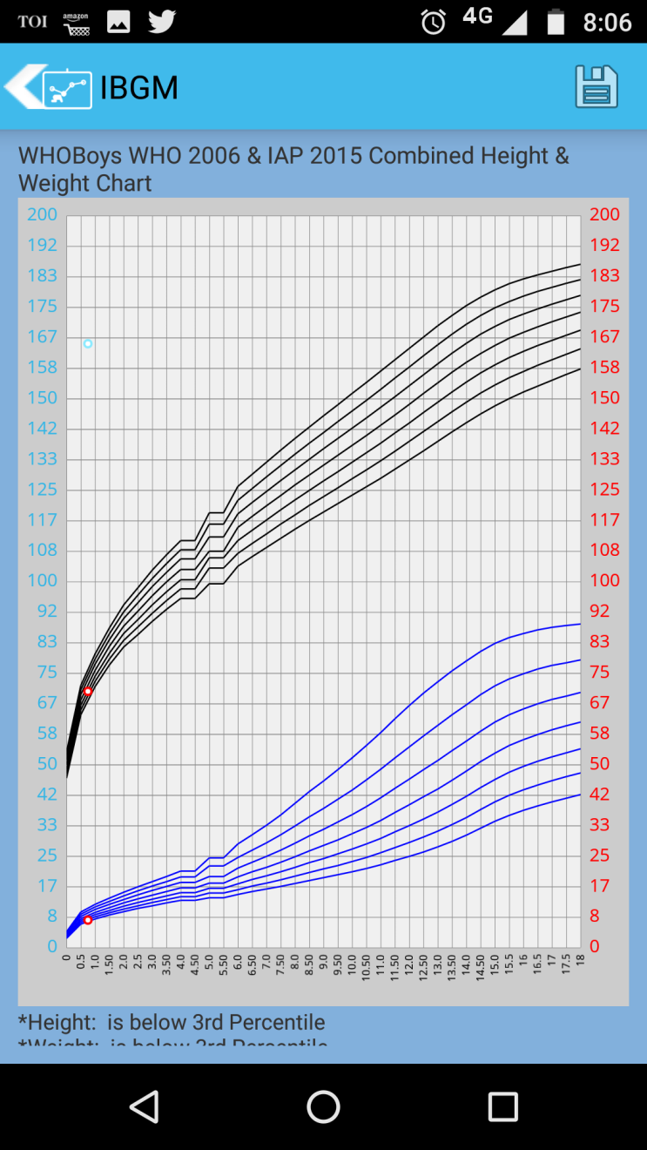

Slide 9
Hence a normal child is classified as short with low weight for age
Weight for height chart is also showing bizzare plotting- it is not taking into accpunt the X axis of height.
MPH is not plotted

Slide 10
Girl
Age- 1.2y
Lt- 75cm
W- 9 kg
HC- 45

Slide 11
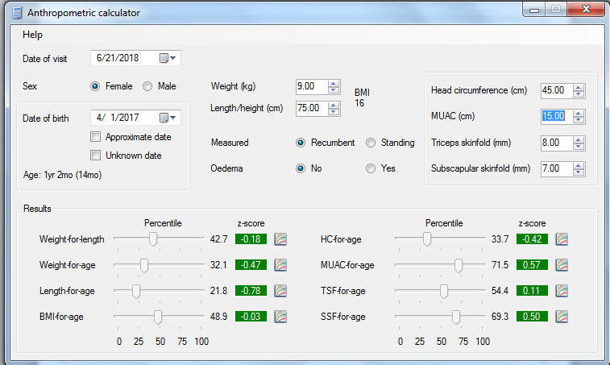
How it should be
Length for age- between 21-22 centile i.e 10th-25th centile
Weight for age- at 32nd centile i.e. 25th- 50th
BMI- at 49th centile i.e. between 25th- 50th centile

Slide 12
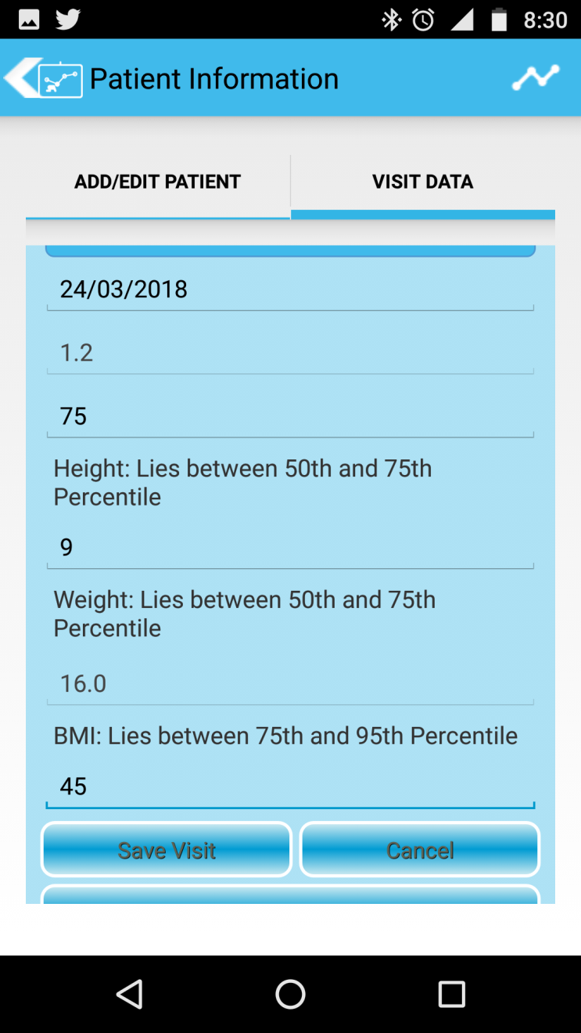
How it Looks

Slide 13
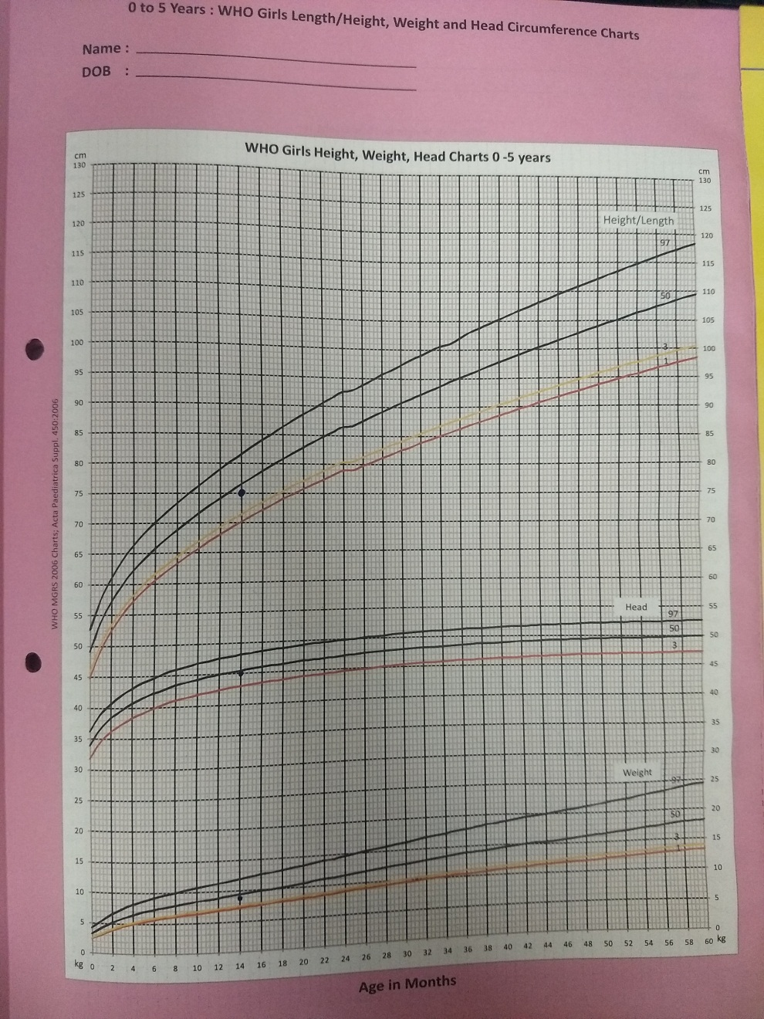
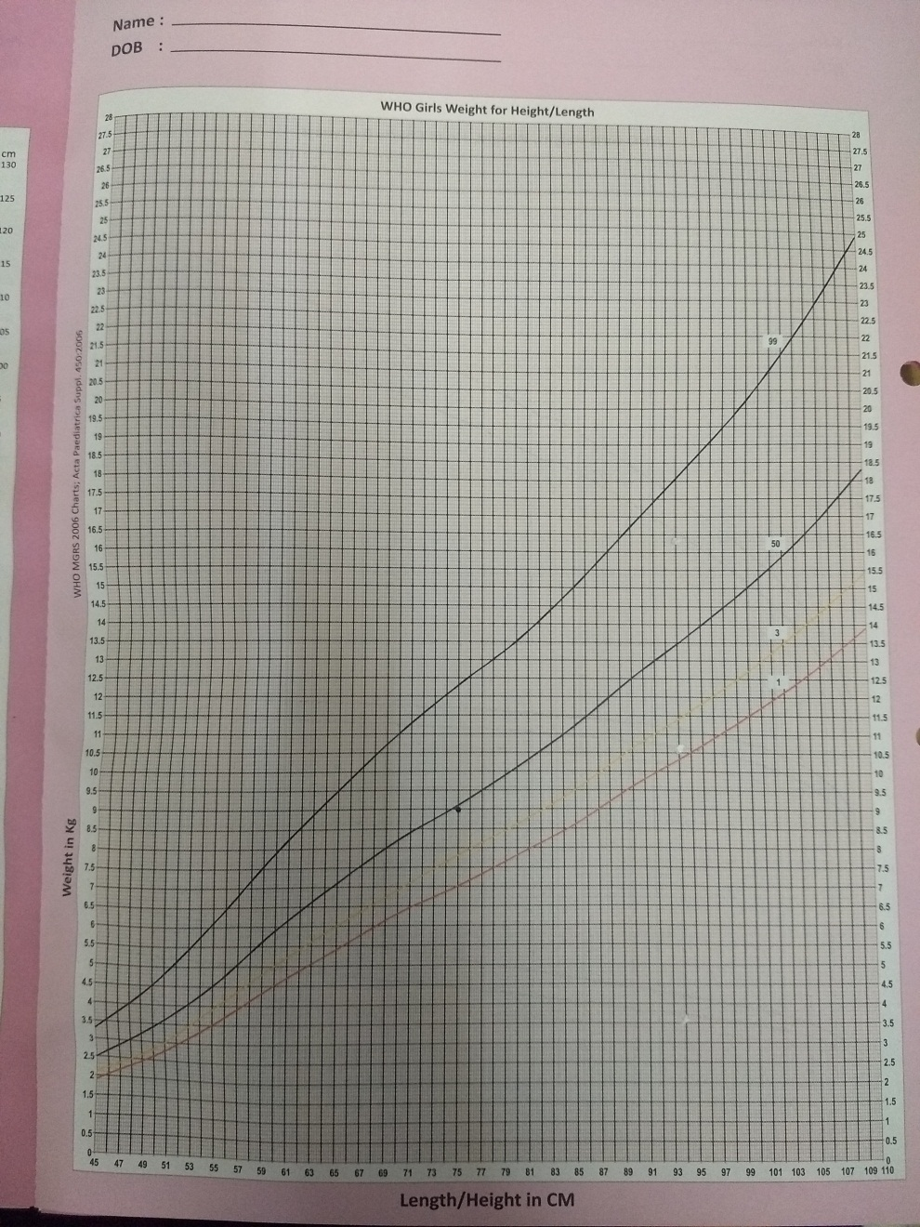
How chart should Look

Slide 14
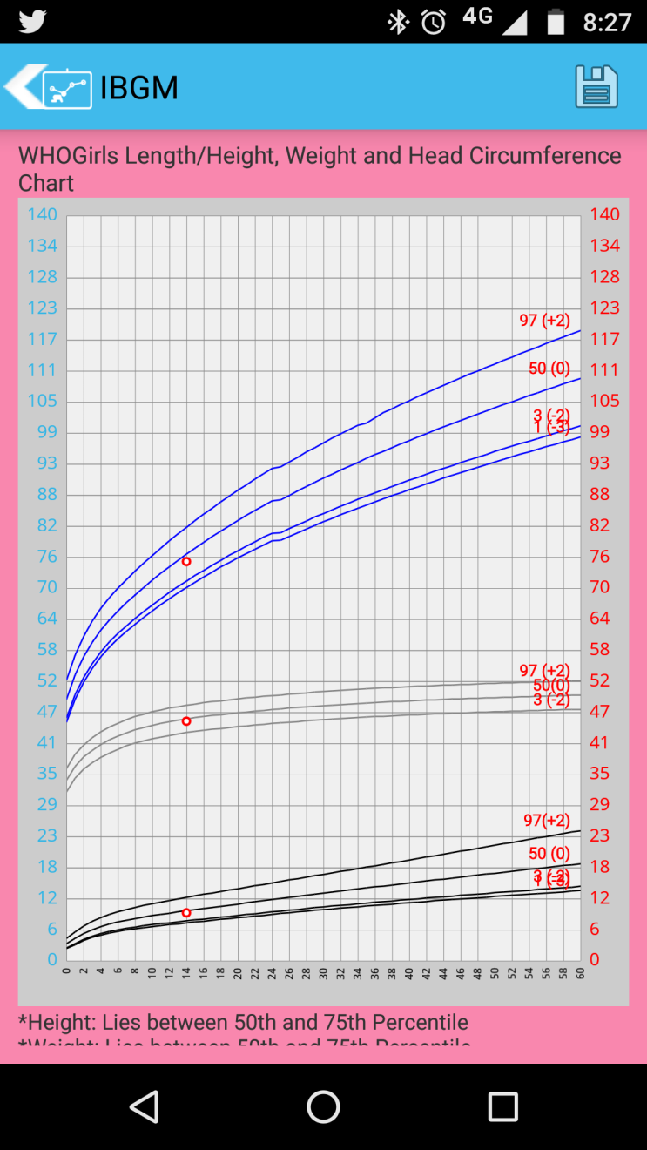
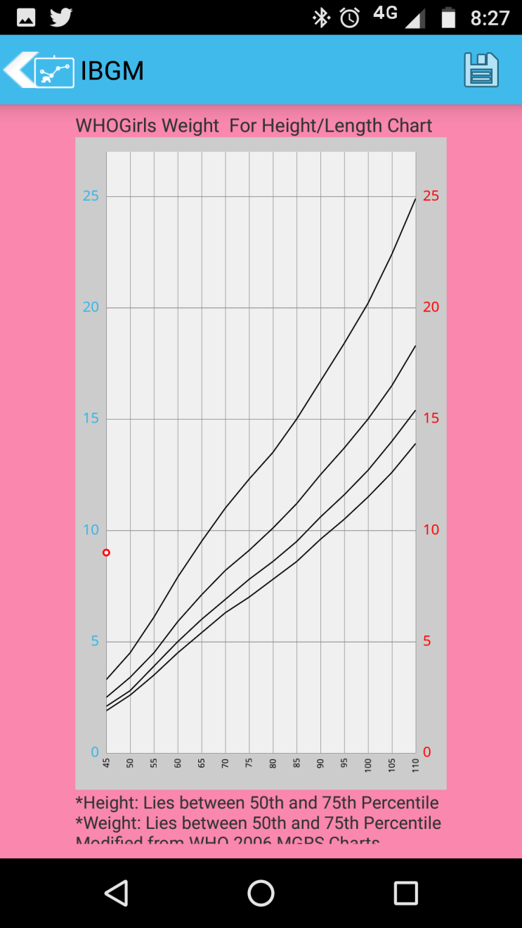
How chart Looks

Slide 15
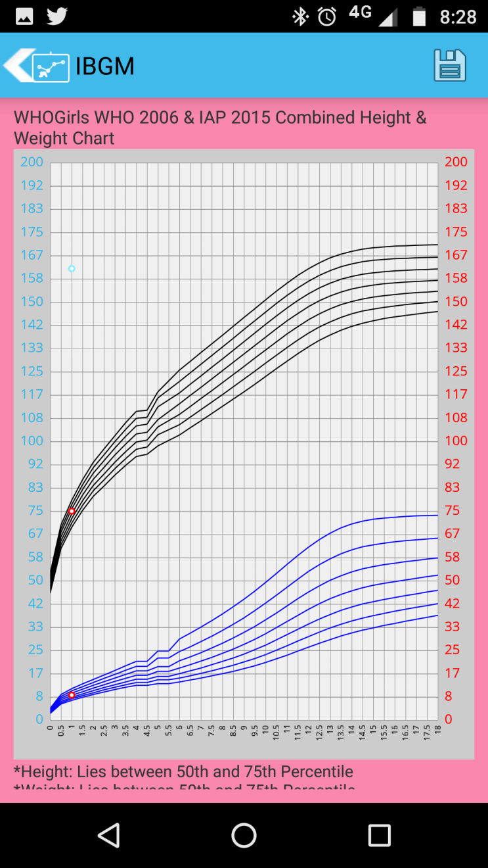
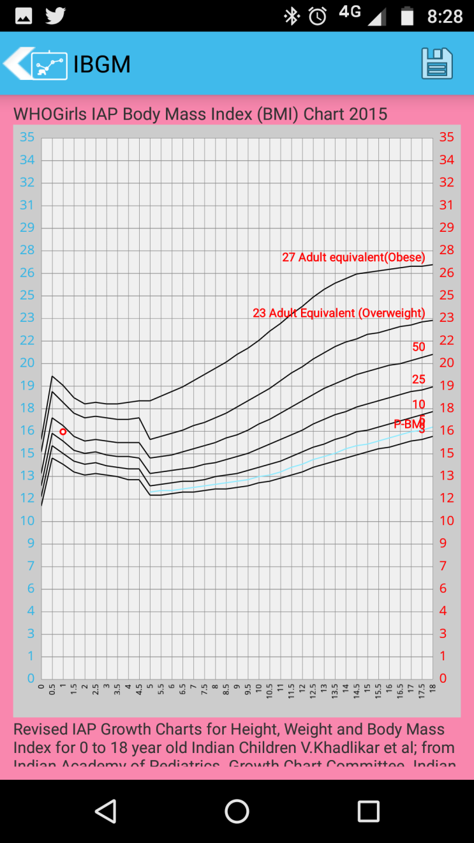
How chart Looks

Slide 16
This girl is over-estimated to be tall with high weight
WFL chart not plotted properly same as above example

Slide 17
5.6 yrs boy
Height- 100cm
Weight- 16 kg

Slide 18
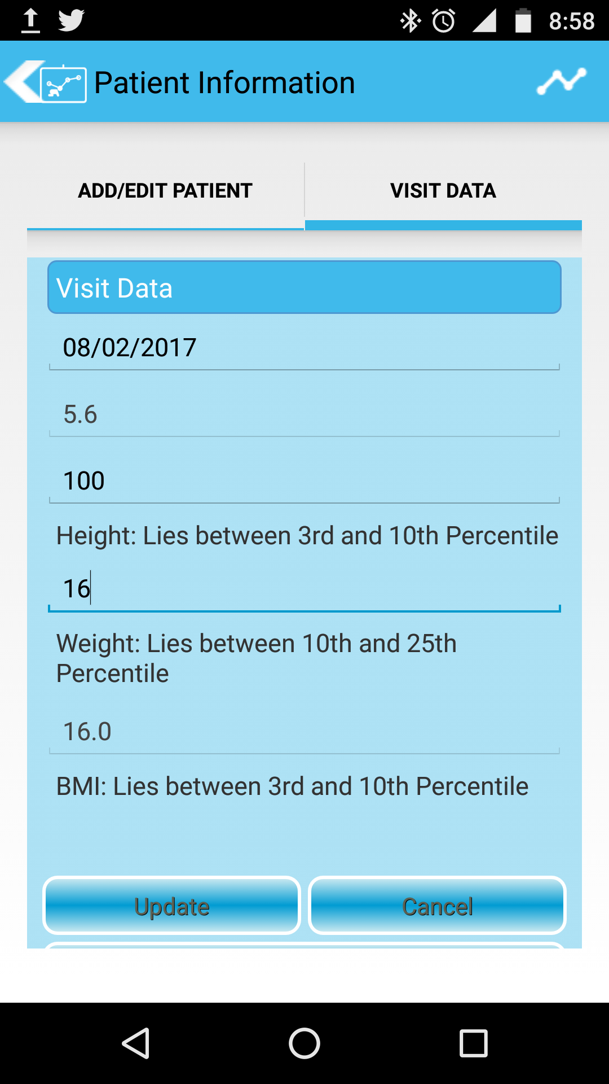
Ht Z- -2.3- < 3rd centile
Weight- -0.87SD- 19th centile between 25th-50th centile
BMI- 0.7 SD- 76th centile between 75th-90th centile

Slide 19
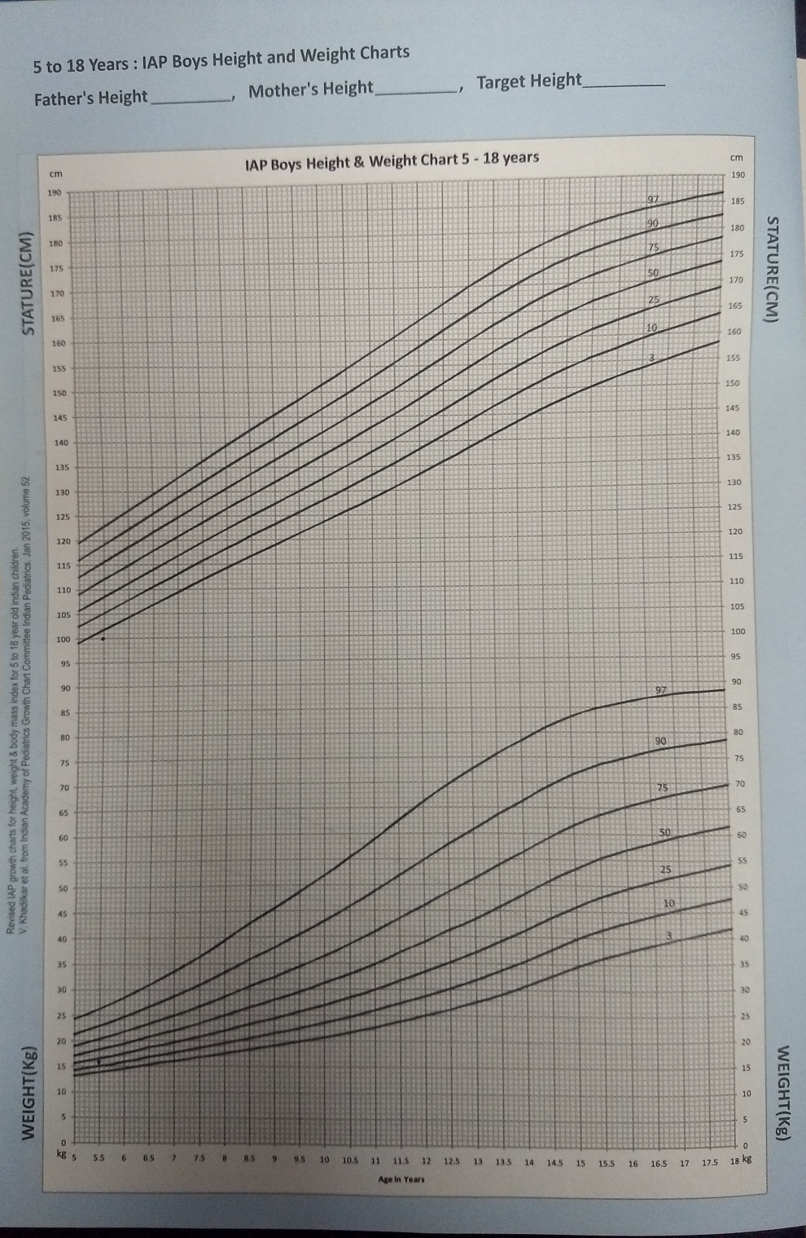
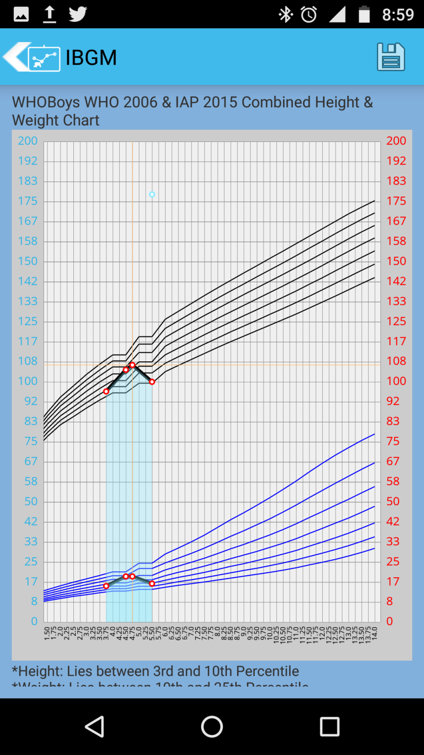

Slide 20
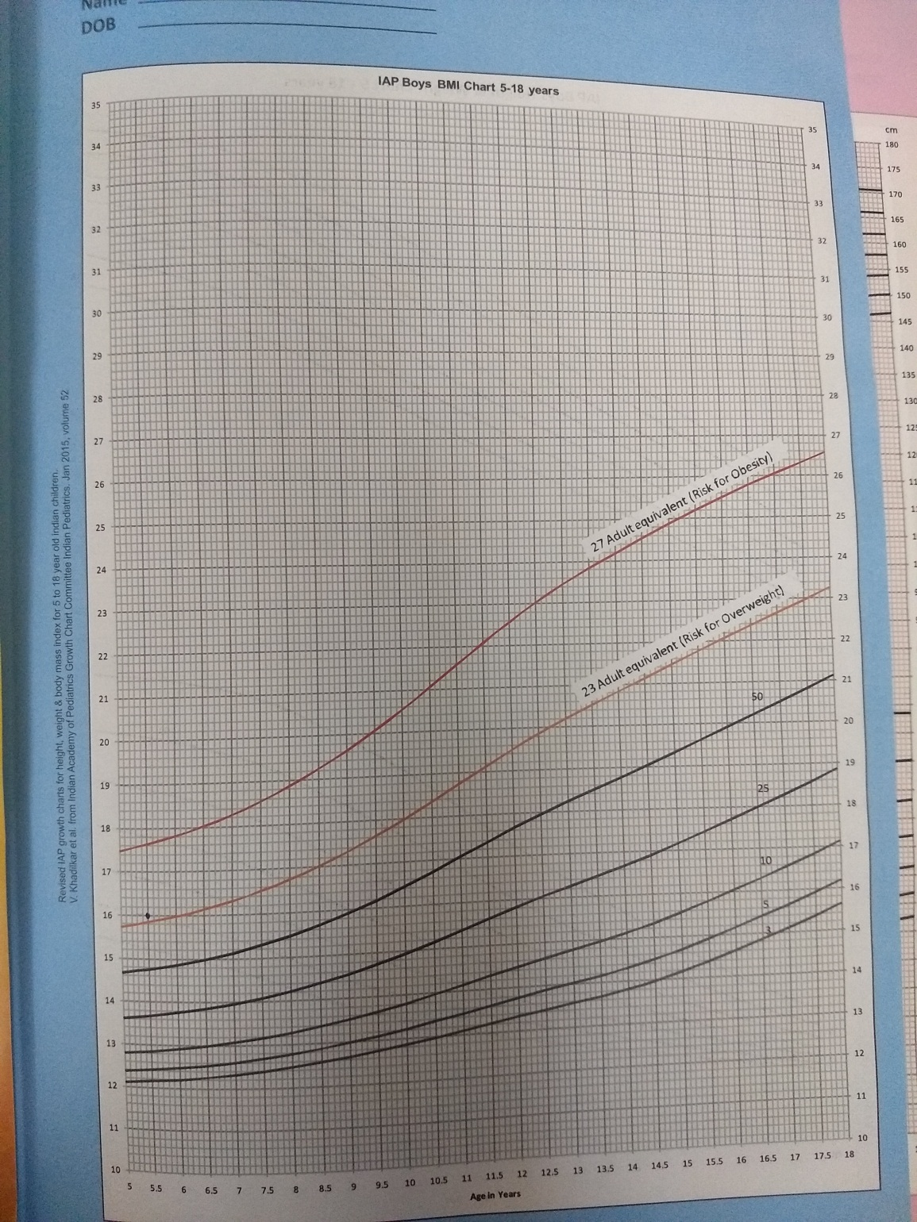
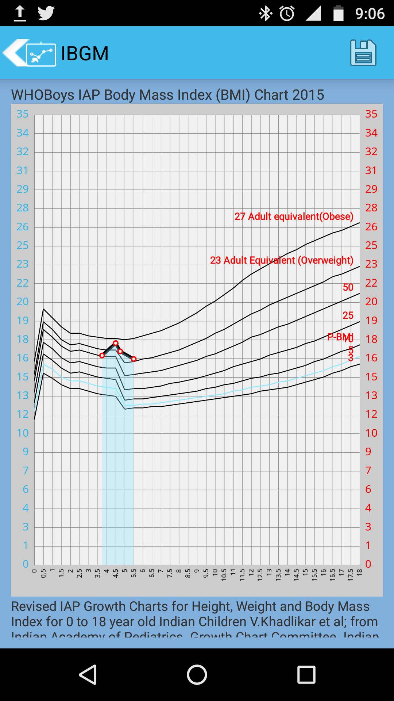

Slide 21
10 yrs
Ht- 145cm
Weight- 32

Slide 22
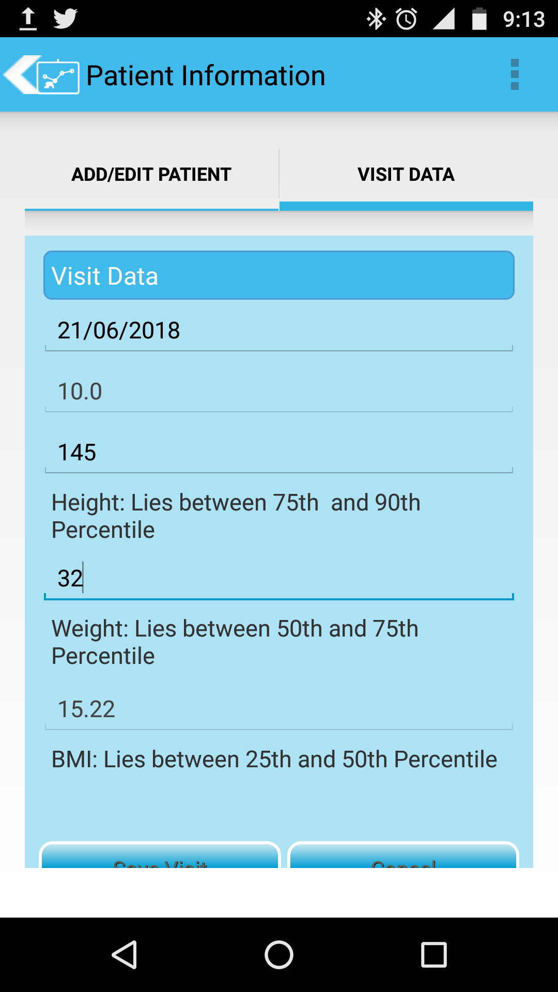
Height- 1.1SD- at 87th centile- 75th-90th centile
Weight- 0.14SD- 56th centile- between 50-75th centile
BMI- -0.52- 80th centile- 75th-90th centile

Slide 23
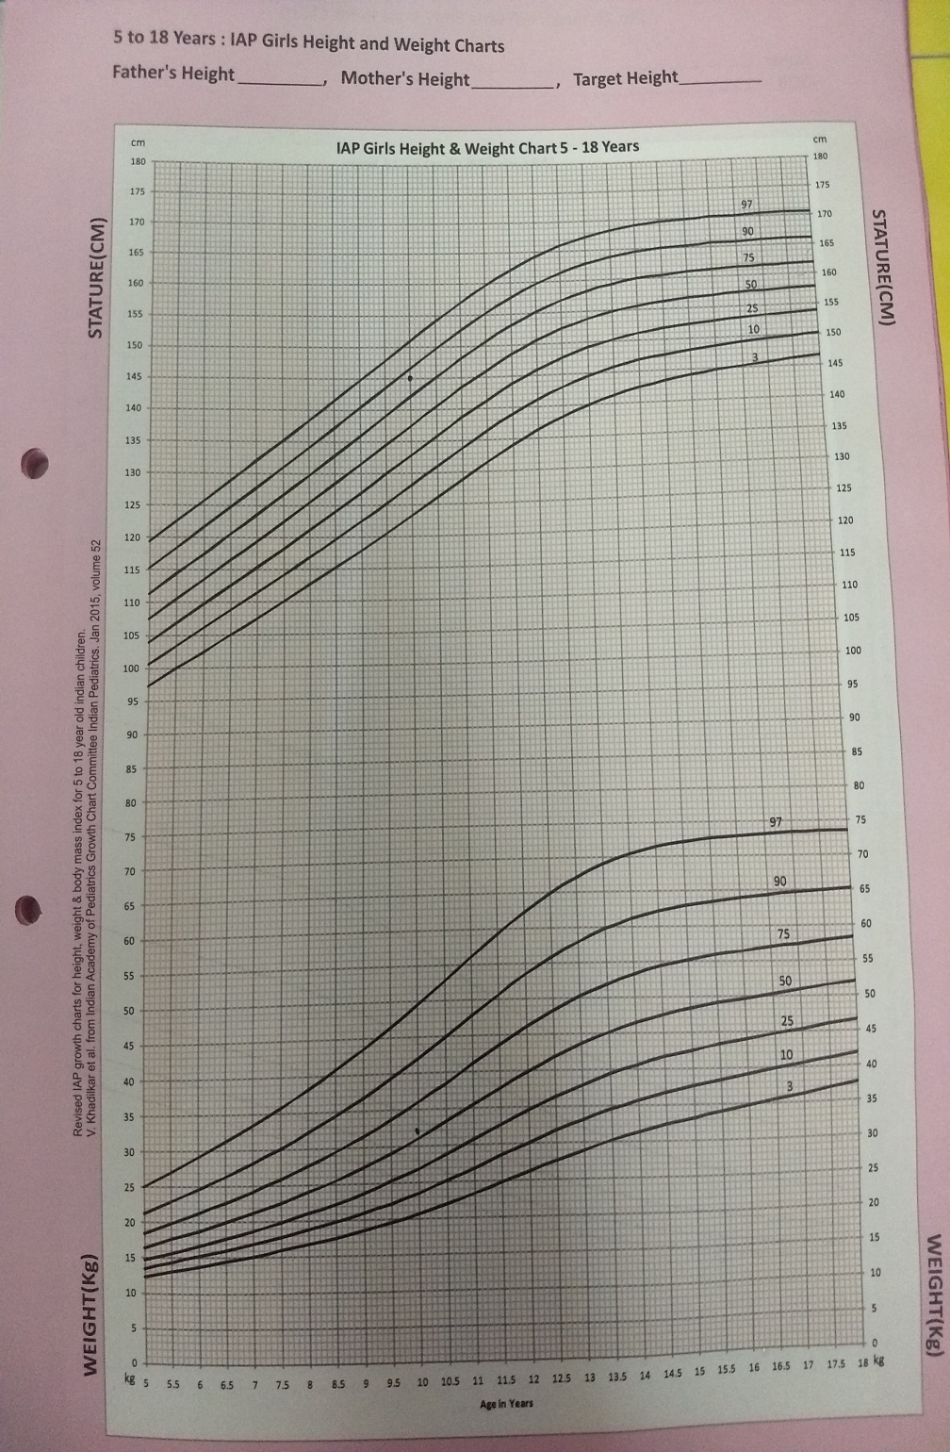
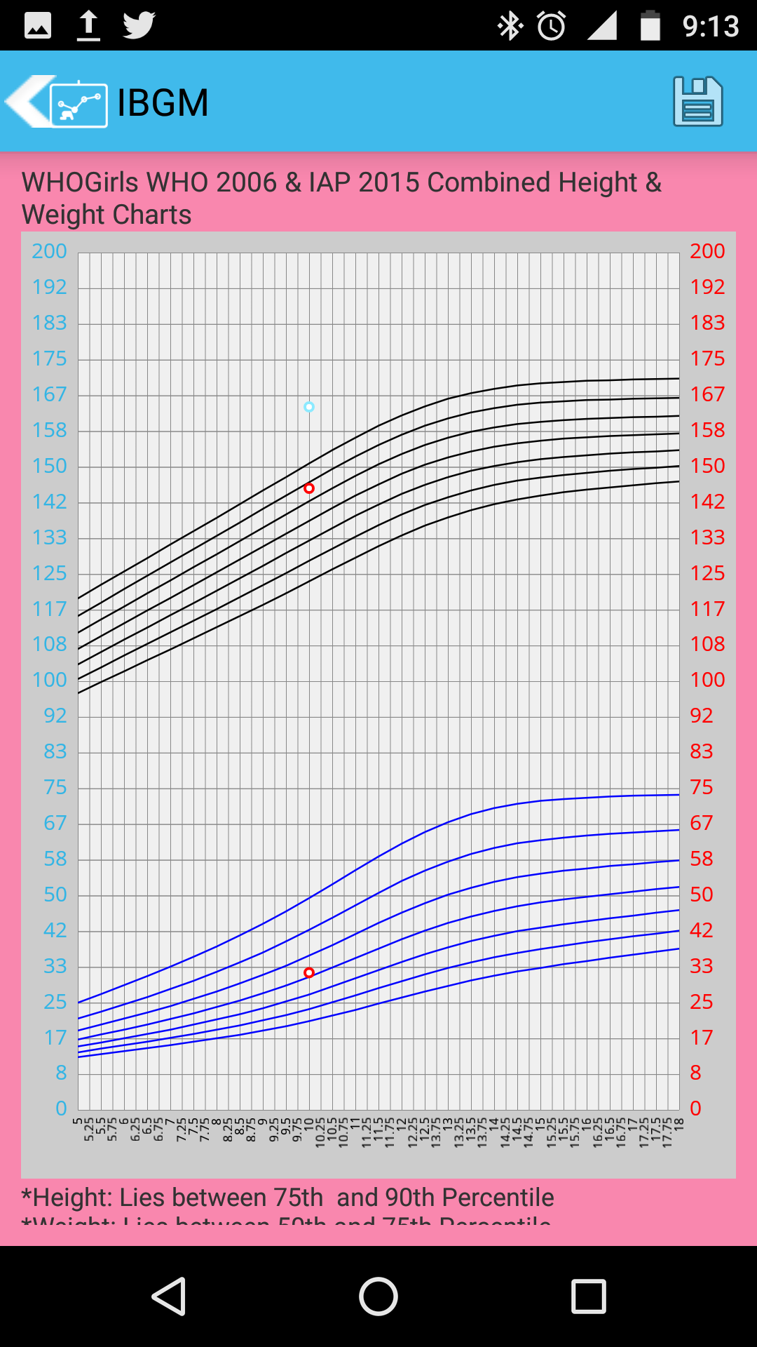

Slide 24
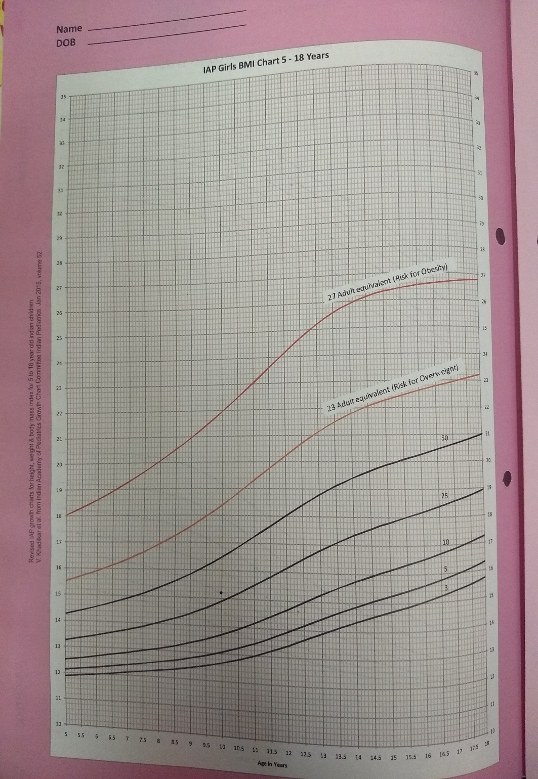
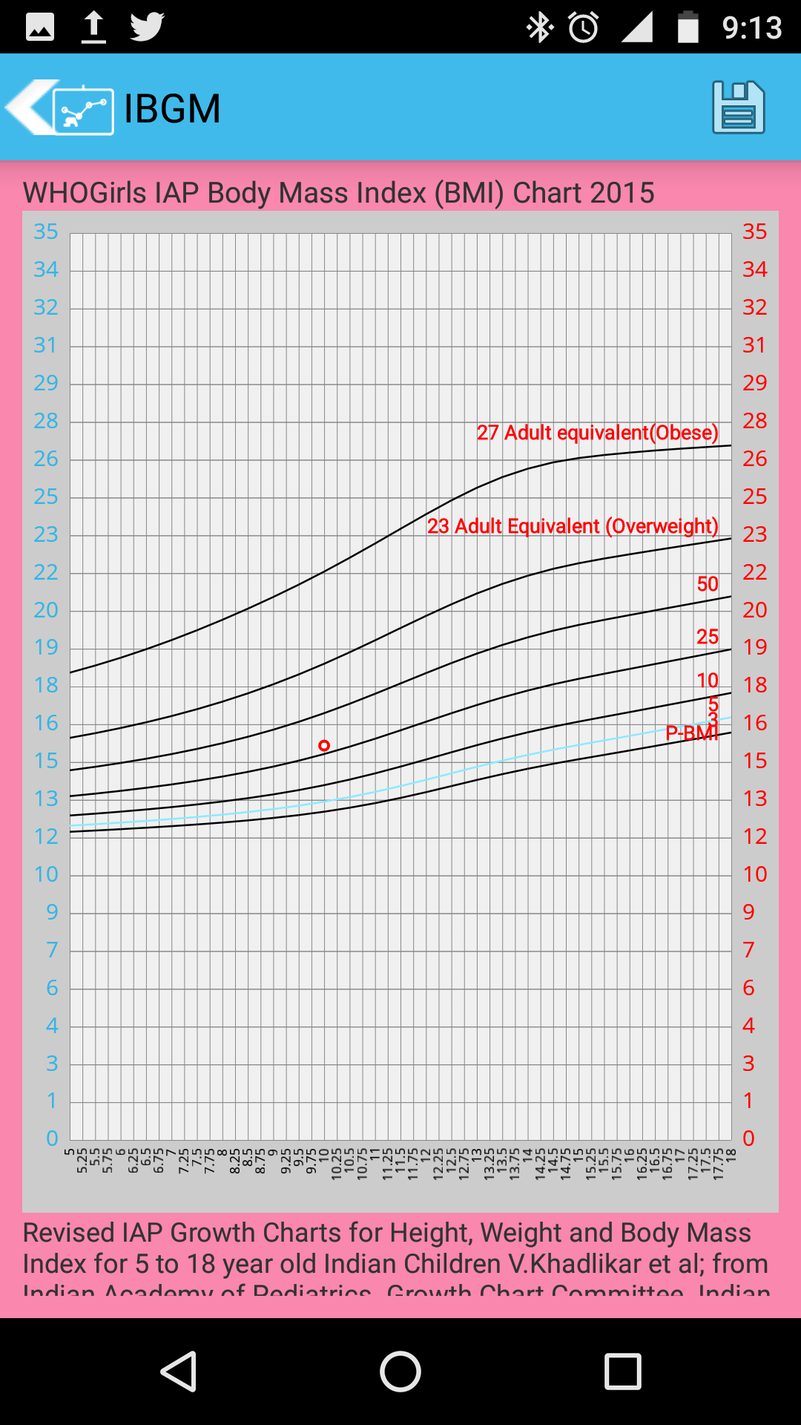

Slide 25
Additional points
Can we directly feed DOB and DOV rather than scrolling- It is very cumbersome especially in an older child
MPH is plotted without considering X axis and that too not always
Back button should get us back to the previous step it just exits us out of the app

